Slide 1

INCOME TAX

Slide 2
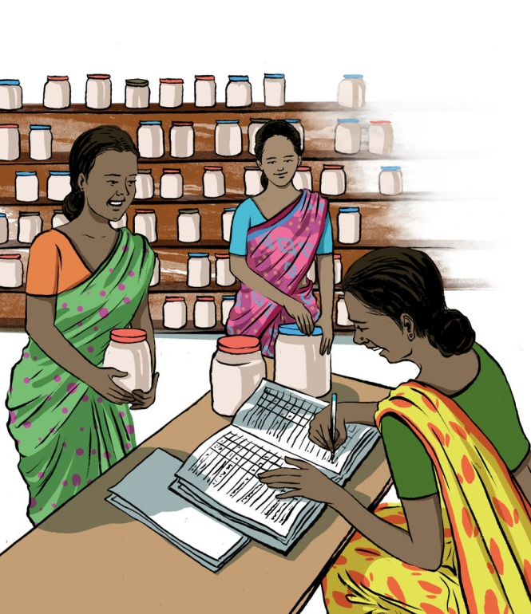
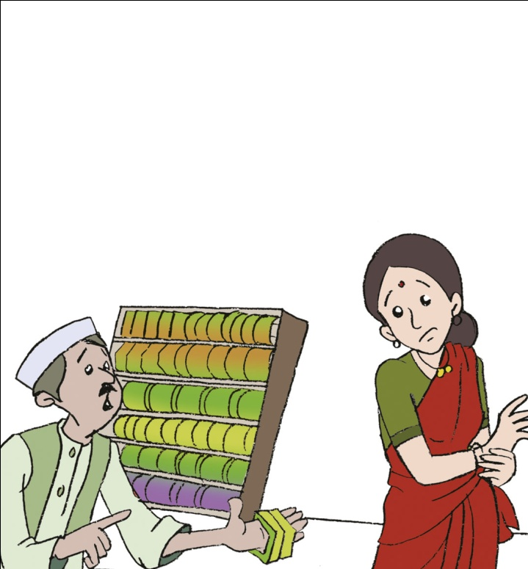

What is Income Tax?
Individuals or Companies sell
Labour
Goods
In return for money called INCOME
Services

Slide 3


What is Income Tax?
If Income
>
Rs. 2,50,000
(2017-2018)
A Part of the Income must be paid to the Government as INCOME TAX

Slide 4


Who Pays Income Tax?
Individuals
Non Individuals such as companies
The amount of Income Tax will vary
Based On:
Amount of Income
Profit
(For Companies)
Occupation
Age
Gender
(For Individuals)

Slide 5
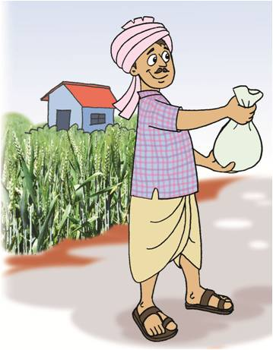
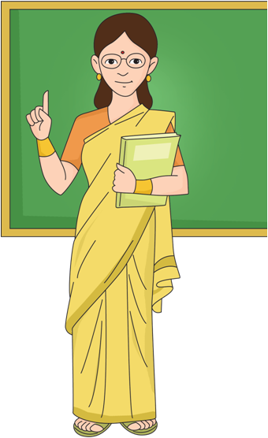
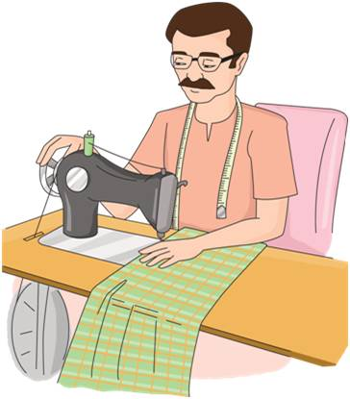



Who Pays Income Tax?
My mother is a teacher. Does she need to pay income tax?
My father is a farmer. Does he need to pay income tax?
My uncle is a tailor. Does he need to pay income tax?
(If Income is above limit)

Slide 6
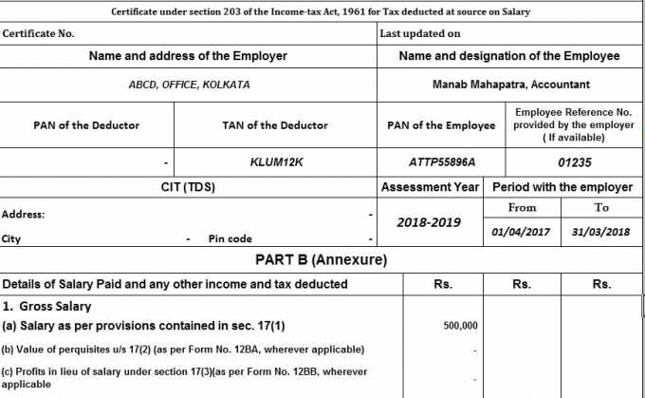
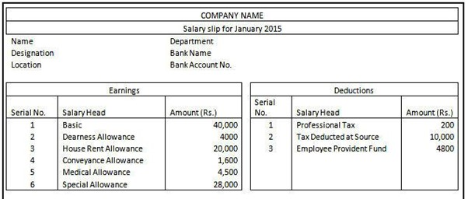
Calculate Tax Based on Salary
Deduct Tax from Salary
Deposit With Government
How do salaried employees pay Income Tax?
Then Companies:
Companies:
Submit Form 16 with Salary and Tax deducted details to Government with a copy to the Employee

Slide 7
How do business people pay Income Tax?
Estimate Taxable Income
Calculate tax they may have to pay
Pay Advance Tax
When the financial year ends…
N
If
Tax Paid is more than Tax Owed
Y
Pay additional tax
Calculate and ask for a refund
How?
Ask a tax consultant
Use sites like: https://www.incometaxindiaefiling.gov.in/

Slide 8
By when does Income Tax have to be paid?
The Income Tax for the Period from:
April
March
1
__
31
2017
2018
Needs to be paid by:
31st
July
2018
30th
Sep
2018
(For Individuals)
(For Companies)

Slide 9
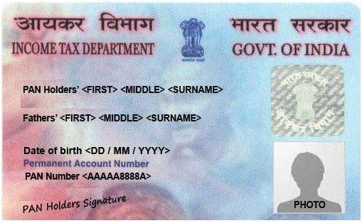
Will the Government know if Income Tax is not paid?
Every Individual or Non Individual that earns Income has a
P
A
N
ermanent
ccount
umber
When Tax is deposited, PAN has to be specified!
The Government does know if and when taxes have been paid

Slide 10
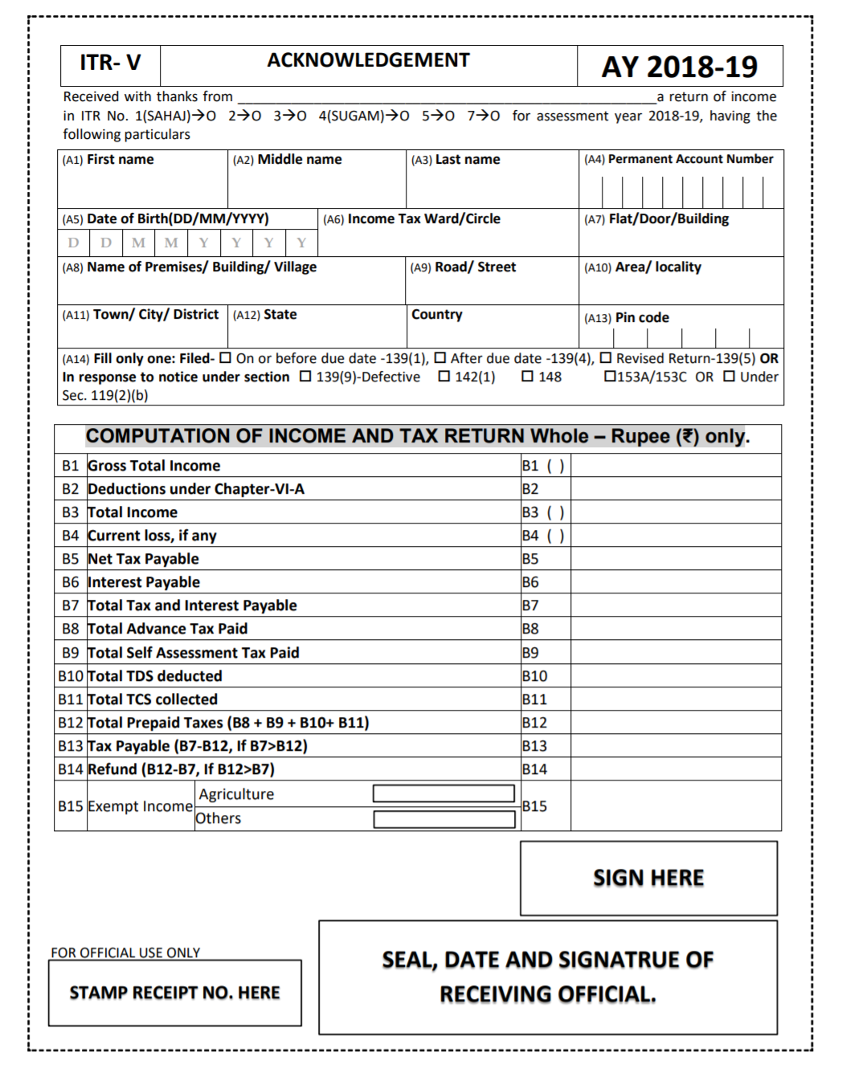

What is an Income Tax Return?
A Form where an individual reports:
His / Her Income
Calculation of tax that needs to be paid
Taxes paid
If Income is over Rs.2,50,000 (Year 2017-2018)

Slide 11

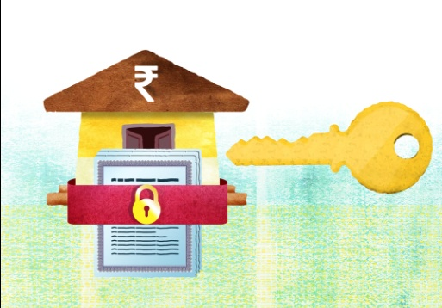


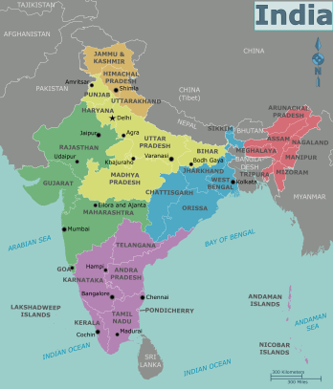

Who should file Income Tax Returns?
Anybody who earns an income should file tax returns!
Even if they earn under Rs. 2,50,000
To be able to get loans
To be able to get higher life insurance cover
To be able to get visas to travel out of India

Slide 12
Last words…
The taxes we pay are used to provide healthcare, education, defense and things like roads, water supply etc.
If you earn an income, apply for a PAN card.
File your income tax returns every year even if your earning is under the limit
Pay your income tax before the due date
Refer to : https://www.incometaxindiaefiling.gov.in/

